Slide 1
NumPy Tutorial

Slide 2
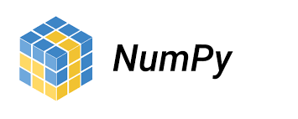
What is Numpy?
NumPy is a Python library used for working with arrays.
It also has functions for working in domain of linear algebra, fourier transform, and matrices.
NumPy was created in 2005 by Travis Oliphant. It is an open source project and you can use it freely.
NumPy stands for Numerical Python.
Why we use Numpy?
In Python we have lists that serve the purpose of arrays, but they are slow to process.
NumPy aims to provide an array object that is up to 50x faster than traditional Python lists.
The array object in NumPy is called ndarray, it provides a lot of supporting functions that make working with ndarray very easy.
Arrays are very frequently used in data science, where speed and resources are very important.

Slide 3

Why is numpy faster than list?
NumPy arrays are stored at one continuous place in memory unlike lists, so processes can access and manipulate them very efficiently.
This behavior is called locality of reference in computer science.
This is the main reason why NumPy is faster than lists. Also it is optimized to work with latest CPU architectures.
Numpy is partially written in python, mostly written in c and c++.

Slide 4
Installation
If you have python installed, we already have pip and then it is easy .
To install that numpy packages ,write the following command in your Terminal.
pip install numpy
Once NumPy is installed, import it in your applications by adding the import keyword:
import numpy
NumPy is usually imported under the np alias.

Slide 5
import numpy as np
Eg:
A normal numpy program.
The version string is stored under __version__ attribute.
import numpy as np
print(np.__version__)

Slide 6
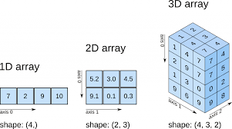
NumPy Creating Arrays
NumPy is used to work with arrays. The array object in NumPy is called ndarray.
We can create a NumPy ndarray object by using the array() function.
Eg:
import numpy as np
arr = np.array([1, 2, 3, 4, 5])
print(arr)
print(type(arr))
output:
[1 2 3 4 5]
<class 'numpy.ndarray'>

Slide 7
type(): This built-in Python function tells us the type of the object passed to it. Like in above code it shows that arr is numpy.ndarray type.
To create an ndarray, we can pass a list, tuple or any array-like object into the array() method, and it will be converted into an ndarray:
Eg:
Use a tuple to create a NumPy array:
import numpy as np
arr = np.array((1, 2, 3, 4, 5))
print(arr)
Output:
[1,2,3,4]

Slide 8
Dimensions in Arrays
A dimension in arrays is one level of array depth (nested arrays).
nested array: are arrays that have arrays as their elements.
0-D Arrays
0-D arrays, or Scalars, are the elements in an array. Each value in an array is a 0-D array.
Create a 0-D array with value 42
import numpy as np
arr = np.array(42)
print(arr)

Slide 9
1-D Arrays
An array that has 0-D arrays as its elements is called uni-dimensional or 1-D array.
These are the most common and basic arrays.
import numpy as np
arr = np.array([1, 2, 3, 4, 5])
print(arr)
2-D Arrays
An array that has 1-D arrays as its elements is called a 2-D array.
These are often used to represent matrix or 2nd order tensors.

Slide 10
NumPy has a whole sub module dedicated towards matrix operations called numpy.mat
eg of 2-d array:
import numpy as np
arr = np.array([[1, 2, 3], [4, 5, 6]])
print(arr)
3-D arrays
An array that has 2-D arrays (matrices) as its elements is called 3-D array.
These are often used to represent a 3rd order tensor.

Slide 11
eg of 3-d array:
import numpy as np
arr = np.array([[[1, 2, 3], [4, 5, 6]], [[1, 2, 3], [4, 5, 6]]])
print(arr)
Output:
[[[1 2 3]
[4 5 6]]
[[1 2 3]
[4 5 6]]]

Slide 12
NumPy Arrays provides the ndim attribute that returns an integer that tells us how many dimensions the array have.
Eg:Check how many dimensions the arrays have
import numpy as np
a = np.array(42)
b = np.array([1, 2, 3, 4, 5])
c = np.array([[1, 2, 3], [4, 5, 6]])
d = np.array([[[1, 2, 3], [4, 5, 6]], [[1, 2, 3], [4, 5, 6]]])
print(a.ndim)
print(b.ndim)
print(c.ndim)
print(d.ndim)

Slide 13
Higher Dimensional Arrays
An array can have any number of dimensions.
When the array is created, you can define the number of dimensions by using the ndmin argument.
eg:Create an array with 5 dimensions and verify that it has 5 dimensions.
import numpy as np
arr = np.array([1, 2, 3, 4], ndmin=5)
print(arr)
print('number of dimensions :', arr.ndim)

Slide 14
In this array the innermost dimension (5th dim) has 4 elements, the 4th dim has 1 element that is the vector, the 3rd dim has 1 element that is the matrix with the vector, the 2nd dim has 1 element that is 3D array and 1st dim has 1 element that is a 4D array.
NumPy Array Indexing
Access Array Elements
Array indexing is the same as accessing an array element.
You can access an array element by referring to its index number.
The indexes in NumPy arrays start with 0, meaning that the first element has index 0, and the second has index 1 etc.
Get the first element from the following array:

Slide 15
import numpy as np
arr = np.array([1, 2, 3, 4])
print(arr[0])
Access 2-D Arrays
To access elements from 2-D arrays we can use comma separated integers representing the dimension and the index of the element.
eg:
Access the 2nd element on 1st dim:

Slide 16
import numpy as np
arr = np.array([[1,2,3,4,5], [6,7,8,9,10]])
print('2nd element on 1st dim: ', arr[0, 1])
Access 3-D Arrays
To access elements from 3-D arrays we can use comma separated integers representing the dimensions and the index of the element.
Eg:
Access the third element of the second array of the first array:

Slide 17
import numpy as np
arr = np.array([[[1, 2, 3], [4, 5, 6]], [[7, 8, 9], [10, 11, 12]]])
print(arr[0, 1, 2])
Output will be 6.
Explanation:
The first number represents the first dimension, which contains two arrays:
[[1, 2, 3], [4, 5, 6]]
and:
[[7, 8, 9], [10, 11, 12]]

Slide 18
Since we selected 0, we are left with the first array:
[[1, 2, 3], [4, 5, 6]]
The second number represents the second dimension, which also contains two arrays:
[1, 2, 3]
and:
[4, 5, 6]
Since we selected 1, we are left with the second array:
[4, 5, 6]
The third number represents the third dimension, which contains three values:
4
5
6

Slide 19
Since we selected 2, we end up with the third value:
6
Negative Indexing
As we known about the negative indexing, we can use that in array too for accessing from last value of the array.
Eg:
Print the last element from the 2nd dim:

Slide 20
import numpy as np
arr = np.array([[1,2,3,4,5], [6,7,8,9,10]])
print('Last element from 2nd dim: ', arr[1, -1])
Output will be 10.
These are the ways we can access the values inside the array.
Now we can see another well known topic called slicing.
Which we will be doing in arrays.

Slide 21
NumPy Array Slicing
Slicing in python means taking elements from one given index to another given index.
We pass slice instead of index like this: [start:end].
We can also define the step, like this: [start:end:step].
If we don't pass start its considered 0
If we don't pass end its considered length of array in that dimension
If we don't pass step it's considered 1.

Slide 22
Eg:
Slice elements from index 1 to index 5 from the following array:
import numpy as np
arr = np.array([1, 2, 3, 4, 5, 6, 7])
print(arr[1:5])
Output will be a array of 2 to 4.
5 will not be there because we know the rule of slicing which is the last value will not print out .

Slide 23
Eg:
Slice elements from index 4 to the end of the array:
import numpy as np
arr = np.array([1, 2, 3, 4, 5, 6, 7])
print(arr[4:])
Output will be [5,6,7]
Slice elements from the beginning to index 4 (not included):
import numpy as np
arr = np.array([1, 2, 3, 4, 5, 6, 7])
print(arr[:4])
Output will be [1,2,3,4]

Slide 24
5 is the value that has index number 4. Which is the end index.
Negative Slicing
And another known term , negative slicing,Use the minus operator to refer to an index from the end.
Eg:
Slice from the index 3 from the end to index 1 from the end:
import numpy as np
arr = np.array([1, 2, 3, 4, 5, 6, 7])
print(arr[-3:-1])

Slide 25
Output will be:[5,6]
STEP
Now we use the step value to determine the step of the slicing:
Eg:
Return every other element from index 1 to index 5:
import numpy as np
arr = np.array([1, 2, 3, 4, 5, 6, 7])
print(arr[1:5:2])
Output will be [2,4].

Slide 26
Eg2:
Return every other element from the entire array:
import numpy as np
arr = np.array([1, 2, 3, 4, 5, 6, 7])
print(arr[::2])
Output will be:[1,3,5,7]
[::] this refers to take whole array, that's why we get the whole array with the count of 2.

Slide 27
Slicing 2-D Arrays
Now we see how to slice the 2-D arrays.
Eg:
From the second element, slice elements from index 1 to index 4 (not included):
import numpy as np
arr = np.array([[1, 2, 3, 4, 5], [6, 7, 8, 9, 10]])
print(arr[1, 1:4])
Output will be:[7,8,9]

Slide 28
eg:
From both elements, return index 2:
import numpy as np
arr = np.array([[1, 2, 3, 4, 5], [6, 7, 8, 9, 10]])
print(arr[0:2, 2])
Output will be [3,8]
eg;
From both elements, slice index 1 to index 4 (not included), this will return a 2-D array:

Slide 29
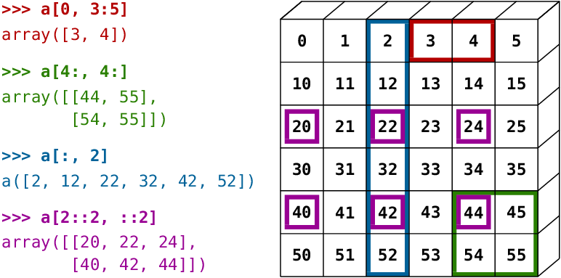
import numpy as np
arr = np.array([[1, 2, 3, 4, 5], [6, 7, 8, 9, 10]])
print(arr[0:2, 1:4])
Output will be a two dimensional array.
[[2 3 4]
[7 8 9]]

Slide 30
NumPy Data Types
By default Python have these data types:
strings - used to represent text data, the text is given under quote marks. e.g. "ABCD"
integer - used to represent integer numbers. e.g. -1, -2, -3
float - used to represent real numbers. e.g. 1.2, 42.42
boolean - used to represent True or False.
complex - used to represent complex numbers. e.g. 1.0 + 2.0j, 1.5 + 2.5j

Slide 31
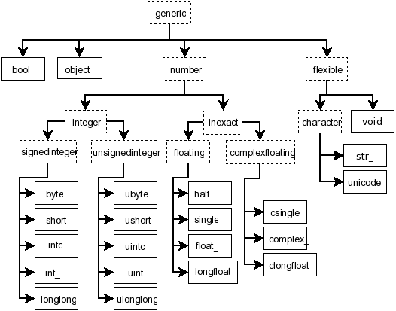
Data Types in NumPy
NumPy has some extra data types, and refer to data types with one character, like i for integers, u for unsigned integers etc.
Below is a list of all data types in NumPy and the characters used to represent them.
i - integer
b - boolean
u - unsigned integer
f - float
c - complex float
m - timedelta
M - datetime
O - object
S - string
U - unicode string
V - fixed chunk of memory for other type ( void )

Slide 32
Checking the Data Type of an Array
The NumPy array object has a property called dtype that returns the data type of the array:
Eg: Get the datatype of the array object.
import numpy as np
arr = np.array([1, 2, 3, 4])
print(arr.dtype)
Output will be : int64

Slide 33
eg:
Get the datatype of an array, which contain string.
import numpy as np
arr = np.array(['apple', 'banana', 'cherry'])
print(arr.dtype)
Output will be: <U6
Which refers to unicode string.

Slide 34
Creating Arrays With a Defined Data Type
We use the array() function to create arrays, this function can take an optional argument: dtype that allows us to define the expected data type of the array elements:
eg:Create an array with data type string:
import numpy as np
arr = np.array([1, 2, 3, 4], dtype='S')
print(arr)
print(arr.dtype)

Slide 35
Output will be:
[b'1' b'2' b'3' b'4']
|S1
For i, u, f, S and U we can define size as well.
Eg:
Create an array with data type 4 bytes integer:
import numpy as np
arr = np.array([1, 2, 3, 4], dtype='i4')
print(arr)
print(arr.dtype)
Output will be:
[1 2 3 4]
int32

Slide 36
What if value cannot be converted?
If a type is given in which elements can't be casted then NumPy will raise a ValueError.
ValueError: In Python ValueError is raised when the type of passed argument to a function is unexpected/incorrect.
eg:
import numpy as np
arr = np.array(['a', '2', '3'], dtype='i')
This will be raising error.

Slide 37
Converting Data Type on Existing Arrays
The best way to change the data type of an existing array, is to make a copy of the array with the astype() method.
The astype() function creates a copy of the array, and allows you to specify the data type as a parameter.
The data type can be specified using a string, like 'f' for float, 'i' for integer etc. or you can use the data type directly like float for float and int for integer.
(It just like conversion in list or tuple)

Slide 38
Eg:
Change data type from float to integer by using 'i' as parameter value:
import numpy as np
arr = np.array([1.1, 2.1, 3.1])
newarr = arr.astype('i')
print(newarr)
print(newarr.dtype)
The output will be:
[1 2 3]
int32

Slide 39
eg: change integer data type to boolean.
import numpy as np
arr = np.array([1, 0, 3])
newarr = arr.astype(bool)
print(newarr)
print(newarr.dtype)
The output will be:
[ True False True]
Bool

Slide 40
NumPy Array Copy vs View
The Difference Between Copy and View
The main difference between a copy and a view of an array is that the copy is a new array, and the view is just a view of the original array.
The copy owns the data and any changes made to the copy will not affect original array, and any changes made to the original array will not affect the copy.
The view does not own the data and any changes made to the view will affect the original array, and any changes made to the original array will affect the view.

Slide 41
eg: Make a copy, change the original array, and display both arrays:[copy example]
import numpy as np
arr = np.array([1, 2, 3, 4, 5])
x = arr.copy()
arr[0] = 42
print(arr)
print(x)
Output will be:
[42 2 3 4 5]
[1 2 3 4 5]

Slide 42
As we can see the copy will not affected by the change of original because it's different.
eg: Make a view, change the original array, and display both arrays:[view example]
import numpy as np
arr = np.array([1, 2, 3, 4, 5])
x = arr.view()
arr[0] = 42
print(arr)
print(x)
Output will be:
[42 2 3 4 5]
[42 2 3 4 5]

Slide 43
It just making another view of the variable arr.
The view SHOULD be affected by the changes made to the original array.
If we make change in view it also affects the original,
Eg:
import numpy as np
arr = np.array([1, 2, 3, 4, 5])
x = arr.view()
x[0] = 31
print(arr)
print(x)

Slide 44
Output will be:
[31 2 3 4 5]
[31 2 3 4 5]
Check if Array Owns it's Data
As mentioned above, copies owns the data, and views does not own the data, but how can we check this?
Every NumPy array has the attribute base that returns None if the array owns the data.
Otherwise, the base attribute refers to the original object.

Slide 45
eg:
Print the value of the base attribute to check if an array owns it's data or not:
import numpy as np
arr = np.array([1, 2, 3, 4, 5])
x = arr.copy()
y = arr.view()
print(x.base)
print(y.base)
Output:
None
[1 2 3 4 5]

Slide 46
The copy returns None.
The view returns the original array.
NumPy Array Shape
The shape of an array is the number of elements in each dimension.
NumPy arrays have an attribute called shape that returns a tuple with each index having the number of corresponding elements.
eg: Print the shape of 2-D array.
import numpy as np
arr = np.array([[1, 2, 3, 4], [5, 6, 7, 8]])
print(arr.shape)

Slide 47
Output will be :(2,4)
The output represents the array is an 2D array which contains 4 elements each.
import numpy as np
arr = np.array([1, 2, 3, 4], ndmin=5)
print(arr)
print('shape of array :', arr.shape)
Output will be:
[[[[[1 2 3 4]]]]]
shape of array : (1, 1, 1, 1, 4)

Slide 48
NumPy Array Reshaping
Reshaping means changing the shape of an array.
The shape of an array is the number of elements in each dimension.
By reshaping we can add or remove dimensions or change number of elements in each dimension.
Reshape From 1-D to 2-D
eg:Convert the following 1-D array with 12 elements into a 2-D array.
The outermost dimension will have 4 arrays, each with 3 elements:

Slide 49
import numpy as np
arr = np.array([1, 2, 3, 4, 5, 6, 7, 8, 9, 10, 11, 12])
newarr = arr.reshape(4, 3)
print(newarr)
Output will be:
[[ 1 2 3]
[ 4 5 6]
[ 7 8 9]
[10 11 12]]

Slide 50
Reshape From 1-D to 3-D
eg:Convert the following 1-D array with 12 elements into a 3-D array.
The outermost dimension will have 2 arrays that contains 3 arrays, each with 2 elements:
import numpy as np
arr = np.array([1, 2, 3, 4, 5, 6, 7, 8, 9, 10, 11, 12])
newarr = arr.reshape(2, 3, 2)
print(newarr)
output:
[[[ 1 2]
[ 3 4]
[ 5 6]]
[[ 7 8]
[ 9 10]
[11 12]]]

Slide 51
Can We Reshape Into any Shape?
Yes, as long as the elements required for reshaping are equal in both shapes.
We can reshape an 8 elements 1D array into 4 elements in 2 rows 2D array but we cannot reshape it into a 3 elements 3 rows 2D array as that would require 3x3 = 9 elements.
Unknown Dimension
You are allowed to have one "unknown" dimension.
Meaning that you do not have to specify an exact number for one of the dimensions in the reshape method.
Pass -1 as the value, and NumPy will calculate this number for you.

Slide 52
import numpy as np
arr = np.array([1, 2, 3, 4, 5, 6, 7, 8])
newarr = arr.reshape(2, 2, -1)
print(newarr)
Output:
[[[1 2]
[3 4]]
[[5 6]
[7 8]]]

Slide 53
Flattening the arrays
Flattening array means converting a multidimensional array into a 1D array.
We can use reshape(-1) to do this.
eg:
Convert the array into a 1D array:
import numpy as np
arr = np.array([[1, 2, 3], [4, 5, 6]])
newarr = arr.reshape(-1)
print(newarr)

Slide 54
NumPy Array Iterating
Iterating means going through elements one by one.
As we deal with multi-dimensional arrays in numpy, we can do this using basic for loop of python.
If we iterate on a 1-D array it will go through each element one by one.
Eg:
Iterate on the elements of the following 1-D array:
import numpy as np
arr = np.array([1, 2, 3])
for x in arr:
print(x)

Slide 55
Iterating 2-D Arrays
In a 2-D array it will go through all the rows.
eg:
Iterate on the elements of the following 2-D array:
import numpy as np
arr = np.array([[1, 2, 3], [4, 5, 6]])
for x in arr:
print(x)
Output:
[1 2 3]
[4 5 6]

Slide 56
To return the actual values, the scalars, we have to iterate the arrays in each dimension.
If we iterate on a n-D array it will go through n-1th dimension one by one.
eg2:
Iterate on each scalar element of the 2-D array:
import numpy as np
arr = np.array([[1, 2, 3], [4, 5, 6]])
for x in arr:
for y in x:
print(y)

Slide 57
Output will be:
1
2
3
4
5
6
Iterating 3D Arrays
In a 3-D array it will go through all the 2-D arrays.
eg:

Slide 58
Iterate on the elements of the following 3-D array:
import numpy as np
arr = np.array([[[1, 2, 3], [4, 5, 6]], [[7, 8, 9], [10, 11, 12]]])
for x in arr:
print(x)
Output will be:
x represents the 2-D array:
[[1 2 3]
[4 5 6]]
x represents the 2-D array:
[[ 7 8 9]
[10 11 12]]
To return the actual values, the scalars, we have to iterate the arrays in each dimension.

Slide 59
eg: Iterate down to the scalars:
import numpy as np
arr = np.array([[[1, 2, 3], [4, 5, 6]], [[7, 8, 9], [10, 11, 12]]])
for x in arr:
for y in x:
for z in y:
print(z)
Output will be the numbers inside the arrays.
1,2,3,4,5,6,7,8,9,10,11,12

Slide 60
Iterating Arrays Using nditer()
The function nditer() is a helping function that can be used from very basic to very advanced iterations. It solves some basic issues which we face in iteration, let's go through it with examples.
Iterating on Each Scalar Element
In basic for loops, iterating through each scalar of an array we need to use n for loops which can be difficult to write for arrays with very high dimensionality.
eg: Iterate through the following 3-D array:
import numpy as np
arr = np.array([[[1, 2], [3, 4]], [[5, 6], [7, 8]]])
for x in np.nditer(arr):
print(x)

Slide 61
Output will be the same as before:
1,2,3,4,5,6,7,8
Iterating Array With Different Data Types
We can use op_dtypes argument and pass it the expected datatype to change the datatype of elements while iterating.
NumPy does not change the data type of the element in-place (where the element is in array) so it needs some other space to perform this action, that extra space is called buffer, and in order to enable it in nditer() we pass flags=['buffered'].
eg:Iterate through the array as a string:
import numpy as np
arr = np.array([1, 2, 3])
for x in np.nditer(arr, flags=['buffered'], op_dtypes=['S']):
print(x)

Slide 62
Output will be the string type of the variable arr.
b'1'
b'2'
b'3'
Iterating With Different Step Size
We can use filtering and followed by iteration.
eg:Iterate through every scalar element of the 2D array skipping 1 element:
import numpy as np
arr = np.array([[1, 2, 3, 4], [5, 6, 7, 8]])
for x in np.nditer(arr[:, ::2]):
print(x)

Slide 63
Enumerated Iteration Using ndenumerate()
Enumeration means mentioning sequence number of somethings one by one.
Sometimes we require corresponding index of the element while iterating, the ndenumerate() method can be used for those usecases.
eg:Enumerate on following 1D arrays elements:
import numpy as np
arr = np.array([1, 2, 3])
for idx, x in np.ndenumerate(arr):
print(idx, x)

Slide 64
Output will be:
(0,) 1
(1,) 2
(2,) 3
eg:
Enumerate on following 2D array's elements:
import numpy as np
arr = np.array([[1, 2, 3, 4], [5, 6, 7, 8]])
for idx, x in np.ndenumerate(arr):
print(idx, x)

Slide 65
Output:
(0, 0) 1
(0, 1) 2
(0, 2) 3
(0, 3) 4
(1, 0) 5
(1, 1) 6
(1, 2) 7
(1, 3) 8

Slide 66
NumPy Joining Array
Joining means putting contents of two or more arrays in a single array.
In SQL we join tables based on a key, whereas in NumPy we join arrays by axes.
We pass a sequence of arrays that we want to join to the concatenate() function, along with the axis. If axis is not explicitly passed, it is taken as 0.
eg:Join two arrays.
import numpy as np
arr1 = np.array([1, 2, 3])
arr2 = np.array([4, 5, 6])
arr = np.concatenate((arr1, arr2))
print(arr)

Slide 67
eg:Join two 2-D arrays along rows (axis=1):
import numpy as np
arr1 = np.array([[1, 2], [3, 4]])
arr2 = np.array([[5, 6], [7, 8]])
arr = np.concatenate((arr1, arr2), axis=1)
print(arr)
Output will be:
[[1 2 5 6]
[3 4 7 8]]

Slide 68
Joining Arrays Using Stack Functions
Stacking is same as concatenation, the only difference is that stacking is done along a new axis.
We can concatenate two 1-D arrays along the second axis which would result in putting them one over the other, ie. stacking.
We pass a sequence of arrays that we want to join to the stack() method along with the axis. If axis is not explicitly passed it is taken as 0.
eg:import numpy as np
arr1 = np.array([1, 2, 3])
arr2 = np.array([4, 5, 6])
arr = np.stack((arr1, arr2), axis=1)
print(arr)

Slide 69
Output will be:
[[1 4]
[2 5]
[3 6]]
Stacking Along Rows
NumPy provides a helper function: hstack() to stack along rows.
import numpy as np
arr1 = np.array([1, 2, 3])
arr2 = np.array([4, 5, 6])
arr = np.hstack((arr1, arr2))
print(arr)

Slide 70
Output will be:
[1 2 3 4 5 6]
Stacking Along Columns
NumPy provides a helper function: vstack() to stack along columns.
eg:
import numpy as np
arr1 = np.array([1, 2, 3])
arr2 = np.array([4, 5, 6])
arr = np.vstack((arr1, arr2))
print(arr)

Slide 71
Output will be:
[[1 2 3]
[4 5 6]]
Stacking Along Height (depth)
NumPy provides a helper function: dstack() to stack along height, which is the same as depth.
import numpy as np
arr1 = np.array([1, 2, 3])
arr2 = np.array([4, 5, 6])
arr = np.dstack((arr1, arr2))
print(arr)

Slide 72
Output will be:
[[[1 4]
[2 5]
[3 6]]]
NumPy Splitting Array
Splitting is reverse operation of Joining.
Joining merges multiple arrays into one and Splitting breaks one array into multiple.
We use array_split() for splitting arrays, we pass it the array we want to split and the number of splits.

Slide 73
eg: Split the array in 3 parts:
import numpy as np
arr = np.array([1, 2, 3, 4, 5, 6])
newarr = np.array_split(arr, 3)
print(newarr)
Output will be:
[array([1, 2]), array([3, 4]), array([5, 6])]
If the array has less elements than required, it will adjust from the end accordingly.

Slide 74
eg: Split the array in 4 parts:
import numpy as np
arr = np.array([1, 2, 3, 4, 5, 6])
newarr = np.array_split(arr, 4)
print(newarr)
Output will be:
[array([1, 2]), array([3, 4]), array([5]), array([6])]
We also have the method split() available but it will not adjust the elements when elements are less in source array for splitting like in example above, array_split() worked properly but split() would fail.

Slide 75
Split Into Arrays
The return value of the array_split() method is an array containing each of the split as an array.
If you split an array into 3 arrays, you can access them from the result just like any array element:
eg:Access the splitted arrays:
import numpy as np
arr = np.array([1, 2, 3, 4, 5, 6])
newarr = np.array_split(arr, 3)
print(newarr[0])
print(newarr[1])
print(newarr[2])

Slide 76
Output will be:
[1 2]
[3 4]
[5 6]
Splitting 2-D Arrays
Use the same syntax when splitting 2-D arrays.
Use the array_split() method, pass in the array you want to split and the number of splits you want to do.
eg:Split the 2-D array into three 2-D arrays.
import numpy as np
arr = np.array([[1, 2], [3, 4], [5, 6], [7, 8], [9, 10], [11, 12]])
newarr = np.array_split(arr, 3)
print(newarr)

Slide 77
Output will be:
[array([[1, 2],
[3, 4]]), array([[5, 6],
[7, 8]]), array([[ 9, 10],
[11, 12]])]
eg2:Split the 2-D array into three 2-D arrays.
import numpy as np
arr = np.array([[1, 2, 3], [4, 5, 6], [7, 8, 9], [10, 11, 12], [13, 14, 15], [16, 17, 18]])
newarr = np.array_split(arr, 3)
print(newarr)

Slide 78
The example above returns three 2-D arrays.
In addition, you can specify which axis you want to do the split around.
The example below also returns three 2-D arrays, but they are split along the row (axis=1).
eg:Split the 2-D array into three 2-D arrays along rows.
import numpy as np
arr = np.array([[1, 2, 3], [4, 5, 6], [7, 8, 9], [10, 11, 12], [13, 14, 15], [16, 17, 18]])
newarr = np.array_split(arr, 3, axis=1)
print(newarr)
Output will be:

Slide 79
[array([[ 1],
[ 4],
[ 7],
[10],
[13],
[16]]), array([[ 2],
[ 5],
[ 8],
[11],
[14],
[17]]), array([[ 3],
[ 6],
[ 9],
[12],
[15],
[18]])]

Slide 80
eg:Use the hsplit() method to split the 2-D array into three 2-D arrays along rows.
import numpy as np
arr = np.array([[1, 2, 3], [4, 5, 6], [7, 8, 9], [10, 11, 12], [13, 14, 15], [16, 17, 18]])
newarr = np.hsplit(arr, 3)
print(newarr)
Similar alternatives to vstack() and dstack() are available as vsplit() and dsplit().

Slide 81
NumPy Searching Arrays
We can search an array for a certain value, and return the indexes that get a match.
To search an array, use the where() method.
eg:Find the indexes where the value is 4:
import numpy as np
arr = np.array([1, 2, 3, 4, 5, 4, 4])
x = np.where(arr == 4)
print(x)
The example above will return a tuple: (array([3, 5, 6],)
Which means that the value 4 is present at index 3, 5, and 6.

Slide 82
eg: Find the indexes where the values are even:
import numpy as np
arr = np.array([1, 2, 3, 4, 5, 6, 7, 8])
x = np.where(arr%2 == 0)
print(x)
Output will be:
(array([1, 3, 5, 7]),)
eg:Find the indexes where the values are odd:
import numpy as np
arr = np.array([1, 2, 3, 4, 5, 6, 7, 8])
x = np.where(arr%2 == 1)
print(x)

Slide 83
Output will be:
(array([0, 2, 4, 6]),)
Search Sorted
There is a method called searchsorted() which performs a binary search in the array, and returns the index where the specified value would be inserted to maintain the search order.
The searchsorted() method is assumed to be used on sorted arrays.
eg:Find the indexes where the value 7 should be inserted:
import numpy as np
arr = np.array([6, 7, 8, 9])
x = np.searchsorted(arr, 7)
print(x)

Slide 84
Output will be 1.
The method starts the search from the left and returns the first index where the number 7 is no longer larger than the next value.
Search From the Right Side
By default the left most index is returned, but we can give side='right' to return the right most index instead.
eg:Find the indexes where the value 7 should be inserted, starting from the right:
import numpy as np
arr = np.array([6, 7, 8, 9])
x = np.searchsorted(arr, 7, side='right')
print(x)
The number 7 should be inserted on index 2 to remain the sort order.

Slide 85
The method starts the search from the right and returns the first index where the number 7 is no longer less than the next value.
Multiple Values
To search for more than one value, use an array with the specified values.
eg:
Find the indexes where the values 2, 4, and 6 should be inserted:
import numpy as np
arr = np.array([1, 3, 5, 7])
x = np.searchsorted(arr, [2, 4, 6])
print(x)
The return value is an array: [1 2 3] containing the three indexes where 2, 4, 6 would be inserted in the original array to maintain the order.

Slide 86
NumPy Sorting Arrays
Sorting means putting elements in an ordered sequence.
Ordered sequence is any sequence that has an order corresponding to elements, like numeric or alphabetical, ascending or descending.
The NumPy ndarray object has a function called sort(), that will sort a specified array.
eg:Sort the array:
import numpy as np
arr = np.array([3, 2, 0, 1])
print(np.sort(arr))
Output :[0 1 2 3]
This method returns a copy of the array, leaving the original array unchanged.

Slide 87
You can also sort arrays of strings, or any other data type:
eg:Sort the array alphabetically:
import numpy as np
arr = np.array(['banana', 'cherry', 'apple'])
print(np.sort(arr))
Output will be:['apple' 'banana' 'cherry']
eg:Sort a boolean array:
import numpy as np
arr = np.array([True, False, True])
print(np.sort(arr))
Output will be:[False True True]

Slide 88
Sorting a 2-D Array
If you use the sort() method on a 2-D array, both arrays will be sorted:
Eg:sort an 2d array.
import numpy as np
arr = np.array([[3, 2, 4], [5, 0, 1]])
print(np.sort(arr))
Output:
[[2 3 4]
[0 1 5]]

Slide 89
NumPy Filter Array
Getting some elements out of an existing array and creating a new array out of them is called filtering.
In NumPy, you filter an array using a boolean index list.
A boolean index list is a list of booleans corresponding to indexes in the array.
If the value at an index is True that element is contained in the filtered array, if the value at that index is False that element is excluded from the filtered array.
eg: Create an array from the elements on index 0 and 2:
import numpy as np
arr = np.array([41, 42, 43, 44])
x = [True, False, True, False]
newarr = arr[x]
print(newarr)

Slide 90
The example above will return [41, 43], why?
Because the new filter contains only the values where the filter array had the value True, in this case, index 0 and 2.
Creating the Filter Array
In the example above we hard-coded the True and False values, but the common use is to create a filter array based on conditions.
Create a filter array that will return only values higher than 42:
import numpy as np
arr = np.array([41, 42, 43, 44])
# Create an empty list
filter_arr = []
# go through each element in arr
for element in arr:
# if the element is higher than 42, set the value to True, otherwise False:
if element > 42:
filter_arr.append(True)
else:
filter_arr.append(False)
newarr = arr[filter_arr]
print(filter_arr)
print(newarr)

Slide 91
output:
[False, False, True, True]
[43 44]
eg:Create a filter array that will return only even elements from the original array:
import numpy as np
arr = np.array([1, 2, 3, 4, 5, 6, 7])
# Create an empty list
filter_arr = []
# go through each element in arr
for element in arr:
# if the element is completely divisible by 2, set the value to True, otherwise False
if element % 2 == 0:
filter_arr.append(True)
else:
filter_arr.append(False)
newarr = arr[filter_arr]
print(filter_arr)
print(newarr)

Slide 92
Output:
[False, True, False, True, False, True, False]
[2 4 6]
Creating Filter Directly From Array
The above example is quite a common task in NumPy and NumPy provides a nice way to tackle it.
We can directly substitute the array instead of the iterable variable in our condition and it will work just as we expect it to.
eg:Create a filter array that will return only values higher than 42:
import numpy as np
arr = np.array([41, 42, 43, 44])
filter_arr = arr > 42
newarr = arr[filter_arr]
print(filter_arr)
print(newarr)

Slide 93
eg: Create a filter array that will return only even elements from the original array:
import numpy as np
arr = np.array([1, 2, 3, 4, 5, 6, 7])
filter_arr = arr % 2 == 0
newarr = arr[filter_arr]
print(filter_arr)
print(newarr)
Output:
[False True False True False True False]
[2 4 6]

Slide 94
Random Numbers in NumPy
Random number does NOT mean a different number every time. Random means something that cannot be predicted logically.
Pseudo Random and True Random.
Computers work on programs, and programs are definitive set of instructions. So it means there must be some algorithm to generate a random number as well.
If there is a program to generate random number it can be predicted, thus it is not truly random.
Random numbers generated through a generation algorithm are called pseudo random.
Can we make truly random numbers?
Yes. In order to generate a truly random number on our computers we need to get the random data from some outside source. This outside source is generally our keystrokes, mouse movements, data on network etc.
We do not need truly random numbers, unless its related to security (e.g. encryption keys) or the basis of application is the randomness (e.g. Digital roulette wheels).

Slide 95
Generate Random Number
NumPy offers the random module to work with random numbers.
eg:Generate a random integer from 0 to 100:
from numpy import random
x = random.randint(100)
print(x)
Output:
95
eg: Generate a random float from 0 to 1:
from numpy import random
x = random.rand()
print(x)
Output:
0.29429030532180533

Slide 96
Generate Random Array
In NumPy we work with arrays, and you can use the two methods from the above examples to make random arrays.
Integers
The randint() method takes a size parameter where you can specify the shape of an array.
eg:Generate a 1-D array containing 5 random integers from 0 to 100:
from numpy import random
x=random.randint(100, size=(5))
print(x)
Output:
[3 91 45 10 92]

Slide 97
eg:Generate a 2-D array with 3 rows, each row containing 5 random integers from 0 to 100:
from numpy import random
x = random.randint(100, size=(3, 5))
print(x)
Output:
[[90 99 11 30 34]
[66 40 63 36 37]
[63 35 89 51 58]]
Floats
The rand() method also allows you to specify the shape of the array.

Slide 98
eg:Generate a 1-D array containing 5 random floats:
from numpy import random
x = random.rand(5)
print(x)
Output:
[0.9439043 0.0615613 0.8464911 0.8322703 0.2007617]
eg:Generate a 2-D array with 3 rows, each row containing 5 random numbers:
from numpy import random
x = random.rand(3, 5)
print(x)

Slide 99
output:
[[0.03379952 0.78263517 0.9834899 0.47851523 0.02948659]
[0.36284007 0.10740884 0.58485016 0.20708396 0.00969559]
[0.88232193 0.86068608 0.75548749 0.61233486 0.06325663]]
Generate Random Number From Array
The choice() method allows you to generate a random value based on an array of values.
The choice() method takes an array as a parameter and randomly returns one of the values.
eg:Return one of the values in an array:
from numpy import random
x = random.choice([3, 5, 7, 9])
print(x)

Slide 100
Output:
5
The choice() method also allows you to return an array of values.
Add a size parameter to specify the shape of the array.
eg:Generate a 2-D array that consists of the values in the array parameter (3, 5, 7, and 9):
from numpy import random
x = random.choice([3, 5, 7, 9], size=(3, 5))
print(x)
output:
[[9 3 5 5 7]
[7 5 3 3 9]
[7 5 9 9 7]]

Slide 101
output:
[[9 3 5 5 7]
[7 5 3 3 9]
[7 5 9 9 7]]
Random Data Distribution
Data Distribution is a list of all possible values, and how often each value occurs.
Such lists are important when working with statistics and data science.
The random module offer methods that returns randomly generated data distributions.
Random Distribution
A random distribution is a set of random numbers that follow a certain probability density function.

Slide 102
Random Distribution
A random distribution is a set of random numbers that follow a certain probability density function.
We can generate random numbers based on defined probabilities using the choice() method of the random module.
The choice() method allows us to specify the probability for each value.
The probability is set by a number between 0 and 1, where 0 means that the value will never occur and 1 means that the value will always occur.
eg:Generate a 1-D array containing 100 values, where each value has to be 3, 5, 7 or 9.
The probability for the value to be 3 is set to be 0.1
The probability for the value to be 5 is set to be 0.3
The probability for the value to be 7 is set to be 0.6
The probability for the value to be 9 is set to be 0
from numpy import random
x = random.choice([3, 5, 7, 9], p=[0.1, 0.3, 0.6, 0.0], size=(100))
print(x)

Slide 103
output:[7 7 7 7 7 5 7 3 7 7 5 7 5 7 3 7 7 7 7 3 7 7 7 5 7 5 7 7 7 3 7 7 3 5 7 7 5 5 7 7 3 7 3 5 7 7 7 7 7 3 7 7 7 7 7 5 7 5 7 5 7 5 5 5 7 7 5 7 5 5 7 5 5 5
7 5 5 7 5 3 7 5 7 5 5 7 7 7 3 5 7 7 7 7 7 7 5 7 5 7]
The sum of all probability numbers should be 1.
Even if you run the example above 100 times, the value 9 will never occur.
You can return arrays of any shape and size by specifying the shape in the size parameter.
eg:Same example as above, but return a 2-D array with 3 rows, each containing 5 values.
from numpy import random
x = random.choice([3, 5, 7, 9], p=[0.1, 0.3, 0.6, 0.0], size=(3, 5))
print(x)
output:
[[7 7 7 5 7]
[7 5 7 7 3]
[5 5 7 7 7]]

Slide 104
Random Permutations
Random Permutations of Elements
A permutation refers to an arrangement of elements. e.g. [3, 2, 1] is a permutation of [1, 2, 3] and vice-versa.
The NumPy Random module provides two methods for this: shuffle() and permutation().
Shuffling Arrays
Shuffle means changing arrangement of elements in-place. i.e. in the array itself.
eg:Randomly shuffle elements of following array:
from numpy import random
import numpy as np
arr = np.array([1, 2, 3, 4, 5])
random.shuffle(arr)
print(arr)

Slide 105
output:
[2 5 4 3 1]
Generating Permutation of Arrays
eg:
Generate a random permutation of elements of following array:
from numpy import random
import numpy as np
arr = np.array([1, 2, 3, 4, 5])
print(random.permutation(arr))

Slide 106
output:
[4 5 3 2 1]
The permutation() method returns a re-arranged array (and leaves the original array un-changed).
Seaborn
Visualize Distributions With Seaborn
Seaborn is a library that uses Matplotlib underneath to plot graphs. It will be used to visualize random distributions.
Install Seaborn
If you have Python and PIP already installed on a system, install it using this command:

Slide 107
Pip install seaborn
Distplots
Distplot stands for distribution plot, it takes as input an array and plots a curve corresponding to the distribution of points in the array.
Import Matplotlib
Import the pyplot object of the Matplotlib module in your code using the following statement:
import matplotlib.pyplot as plt
Import Seaborn
Import the Seaborn module in your code using the following statement:
import seaborn as sns

Slide 108
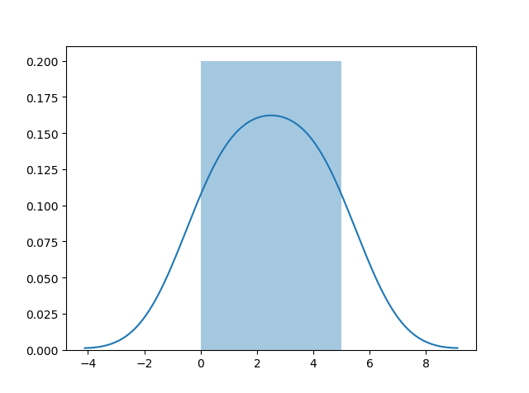
Plotting a Displot
import matplotlib.pyplot as plt
import seaborn as sns
sns.distplot([0, 1, 2, 3, 4, 5])
plt.show()

Slide 109
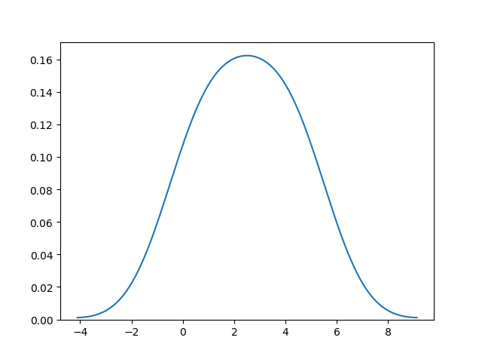
Plotting a Distplot Without the Histogram
import matplotlib.pyplot as plt
import seaborn as sns
sns.distplot([0, 1, 2, 3, 4, 5], hist=False)
plt.show()

Slide 110
We will be using: sns.distplot(arr, hist=False) to visualize random distributions.
Normal (Gaussian) Distribution
The Normal Distribution is one of the most important distributions.
It is also called the Gaussian Distribution after the German mathematician Carl Friedrich Gauss.
It fits the probability distribution of many events, eg. IQ Scores, Heartbeat etc.
Use the random.normal() method to get a Normal Data Distribution.
It has three parameters:
loc - (Mean) where the peak of the bell exists.
scale - (Standard Deviation) how flat the graph distribution should be.
size - The shape of the returned array.

Slide 111
eg:Generate a random normal distribution of size 2x3:
from numpy import random
x = random.normal(size=(2, 3))
print(x)
output:
[[ 0.45621732 -0.94860598 0.91850642]
[-0.30662985 0.2857098 1.17587079]]
Generate a random normal distribution of size 2x3 with mean at 1 and standard deviation of 2:
from numpy import random
x = random.normal(loc=1, scale=2, size=(2, 3))
print(x)

Slide 112
output:
[[-0.88649191 1.17519215 2.31307245]
[ 2.43740755 0.66415318 -0.69303517]]
Visualization of Normal Distribution
from numpy import random
import matplotlib.pyplot as plt
import seaborn as sns
sns.distplot(random.normal(size=1000), hist=False)
plt.show()

Slide 113
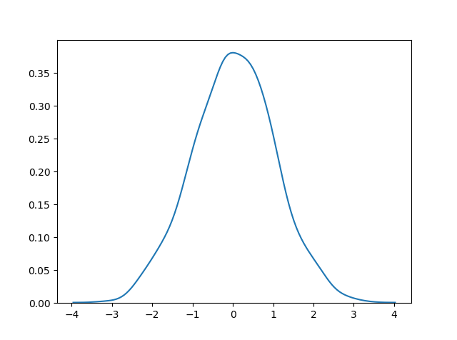

Slide 114
Binomial Distribution
Binomial Distribution is a Discrete Distribution.
It describes the outcome of binary scenarios, e.g. toss of a coin, it will either be head or tails.
It has three parameters:
n - number of trials.
p - probability of occurrence of each trial (e.g. for toss of a coin 0.5 each).
size - The shape of the returned array.

Slide 115
Discrete Distribution:The distribution is defined at separate set of events, e.g. a coin toss's result is discrete as it can be only head or tails whereas height of people is continuous as it can be 170, 170.1, 170.11 and so on.
eg: Given 10 trials for coin toss generate 10 data points:
from numpy import random
x = random.binomial(n=10, p=0.5, size=10)
print(x)
Output;
[8 4 6 4 5 8 7 9 6 3]

Slide 116
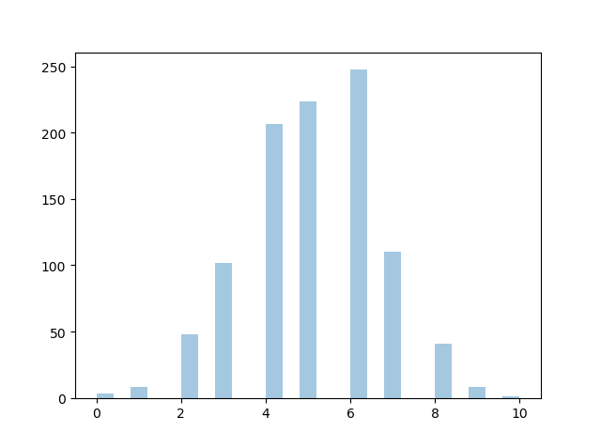
Visualization of Binomial Distribution
from numpy import random
import matplotlib.pyplot as plt
import seaborn as sns
sns.distplot(random.binomial(n=10, p=0.5, size=1000), hist=True, kde=False
plt.show()

Slide 117
Difference Between Normal and Binomial Distribution
The main difference is that normal distribution is continuous whereas binomial is discrete, but if there are enough data points it will be quite similar to normal distribution with certain loc and scale.
from numpy import random
import matplotlib.pyplot as plt
import seaborn as sns
sns.distplot(random.normal(loc=50, scale=5, size=1000), hist=False, label='normal')
sns.distplot(random.binomial(n=100, p=0.5, size=1000), hist=False, label='binomial')
plt.show()

Slide 118
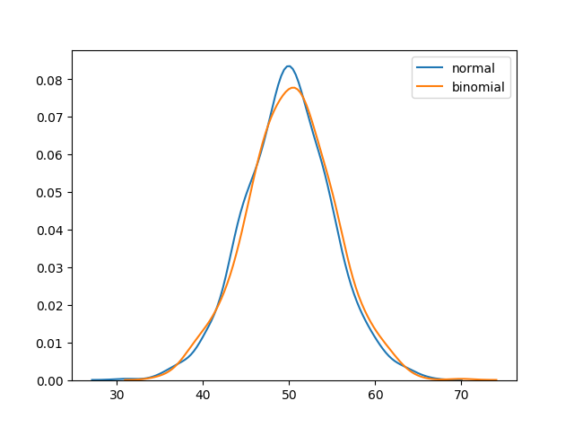

Slide 119
Poisson Distribution
Poisson Distribution is a Discrete Distribution.
It estimates how many times an event can happen in a specified time. e.g. If someone eats twice a day what is probability he will eat thrice?
It has two parameters:
lam - rate or known number of occurrences e.g. 2 for above problem.
size - The shape of the returned array.
eg:Generate a random 1x10 distribution for occurence 2:
from numpy import random
x = random.poisson(lam=2, size=10)
print(x)

Slide 120
Output;
[2 2 3 4 0 0 4 0 1 1]
Visualization of Poisson Distribution
from numpy import random
import matplotlib.pyplot as plt
import seaborn as sns
sns.distplot(random.poisson(lam=2, size=1000), kde=False)
plt.show()

Slide 121
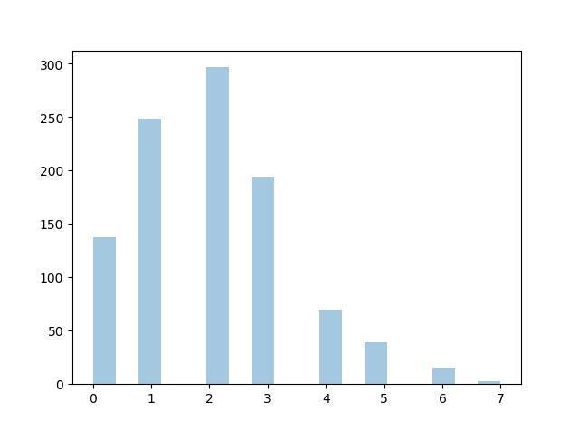
Difference Between Normal and Poisson Distribution
Normal distribution is continuous whereas poisson is discrete.
But we can see that similar to binomial for a large enough poisson distribution it will become similar to normal distribution with certain std dev and mean.

Slide 122
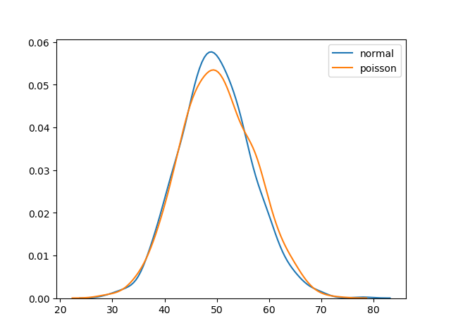
from numpy import random
import matplotlib.pyplot as plt
import seaborn as sns
sns.distplot(random.normal(loc=50, scale=7, size=1000), hist=False, label='normal')
sns.distplot(random.poisson(lam=50, size=1000), hist=False, label='poisson')
plt.show()

Slide 123
Difference Between Poisson and Binomial Distribution
The difference is very subtle it is that, binomial distribution is for discrete trials, whereas poisson distribution is for continuous trials.
But for very large n and near-zero p binomial distribution is near identical to poisson distribution such that n * p is nearly equal to lam.
eg:from numpy import random
import matplotlib.pyplot as plt
import seaborn as sns
sns.distplot(random.binomial(n=1000, p=0.01, size=1000), hist=False, label='binomial')
sns.distplot(random.poisson(lam=10, size=1000), hist=False, label='poisson')
plt.show()

Slide 124
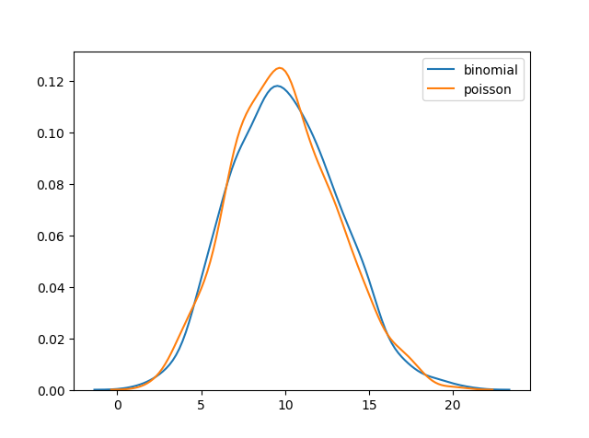

Slide 125
Uniform Distribution
Used to describe probability where every event has equal chances of occuring.
E.g. Generation of random numbers.
It has three parameters:
a - lower bound - default 0 .0.
b - upper bound - default 1.0.
size - The shape of the returned array.

Slide 126
eg:Create a 2x3 uniform distribution sample:
from numpy import random
x = random.uniform(size=(2, 3))
print(x)
output:
[[0.98192463 0.69801102 0.0085457 ]
[0.50822162 0.15550701 0.25819602]]
Visualization of Uniform Distribution
from numpy import random
import matplotlib.pyplot as plt
import seaborn as sns
sns.distplot(random.uniform(size=1000), hist=False)
plt.show()

Slide 127
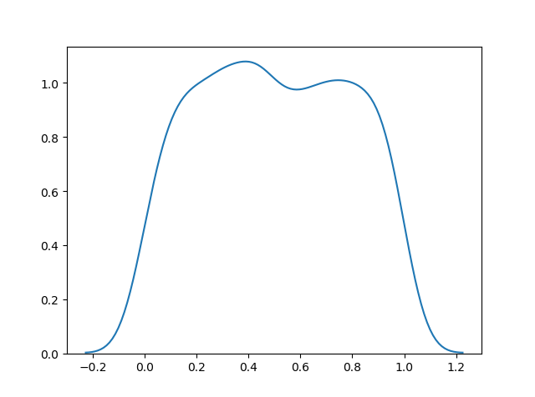

Slide 128
Logistic Distribution
Logistic Distribution is used to describe growth.
Used extensively in machine learning in logistic regression, neural networks etc.
It has three parameters:
loc - mean, where the peak is. Default 0.
scale - standard deviation, the flatness of distribution. Default 1.
size - The shape of the returned array.

Slide 129
eg:Draw 2x3 samples from a logistic distribution with mean at 1 and stddev 2.0:
from numpy import random
x = random.logistic(loc=1, scale=2, size=(2, 3))
print(x)
output:
[[10.93492709 -0.75451513 1.97030077]
[ 3.82674113 6.98834191 3.25876766]]

Slide 130
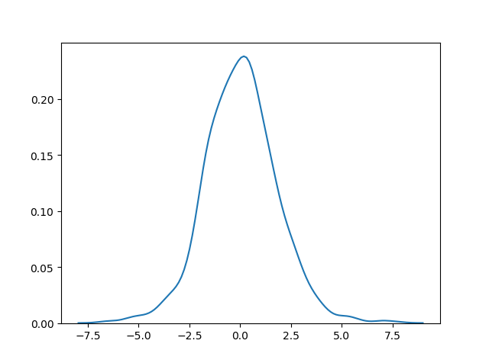
Visualization of Logistic Distribution
from numpy import random
import matplotlib.pyplot as plt
import seaborn as sns
sns.distplot(random.logistic(size=1000), hist=False)
plt.show()

Slide 131
Difference Between Logistic and Normal Distribution
Both distributions are near identical, but logistic distribution has more area under the tails. ie. It representage more possibility of occurrence of an events further away from mean.
For higher value of scale (standard deviation) the normal and logistic distributions are near identical apart from the peak.
eg:
from numpy import random
import matplotlib.pyplot as plt
import seaborn as sns
sns.distplot(random.normal(scale=2, size=1000), hist=False, label='normal')
sns.distplot(random.logistic(size=1000), hist=False, label='logistic')
plt.show()

Slide 132
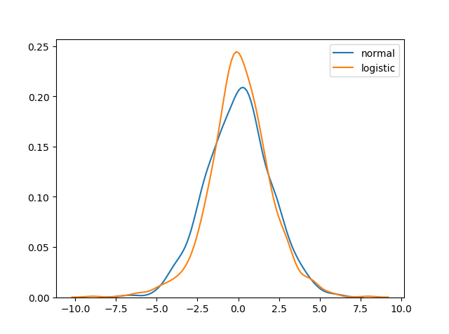

Slide 133
Multinomial Distribution
Multinomial distribution is a generalization of binomial distribution.
It describes outcomes of multi-nomial scenarios unlike binomial where scenarios must be only one of two. e.g. Blood type of a population, dice roll outcome.
It has three parameters:
n - number of possible outcomes (e.g. 6 for dice roll).
pvals - list of probabilities of outcomes (e.g. [1/6, 1/6, 1/6, 1/6, 1/6, 1/6] for dice roll).
size - The shape of the returned array.

Slide 134
Multinomial samples will NOT produce a single value! They will produce one value for each pval.
As they are generalization of binomial distribution their visual representation and similarity of normal distribution is same as that of multiple binomial distributions.
Exponential Distribution
Exponential distribution is used for describing time till next event e.g. failure/success etc.
It has two parameters:
scale - inverse of rate ( see lam in poisson distribution ) defaults to 1.0.
size - The shape of the returned array.

Slide 135
eg: Draw out a sample for exponential distribution with 2.0 scale with 2x3 size:
from numpy import random
x = random.exponential(scale=2, size=(2, 3))
print(x)
output:
[[3.2193401 0.36629328 1.05771478]
[0.11261256 0.20269054 0.69513177]]
Visualization of Exponential Distribution
from numpy import random
import matplotlib.pyplot as plt
import seaborn as sns
sns.distplot(random.exponential(size=1000), hist=False)
plt.show()

Slide 136
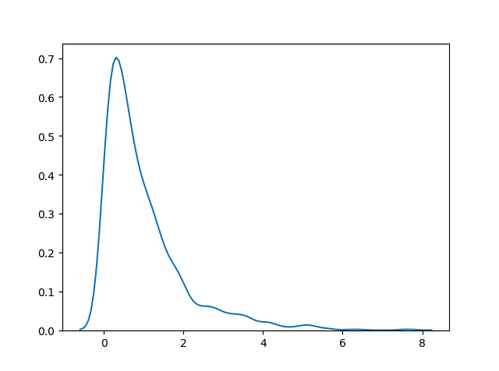
Relation B/W Poisson and Exponential Distribution
Poisson distribution deals with number of occurrences of an event in a time period whereas exponential distribution deals with the time between these events.

Slide 137
Chi Square Distribution
Chi Square distribution is used as a basis to verify the hypothesis.
It has two parameters:
df - (degree of freedom).
size - The shape of the returned array.
Draw out a sample for chi squared distribution with degree of freedom 2 with size 2x3:
from numpy import random
x = random.chisquare(df=2, size=(2, 3))
print(x)

Slide 138
output:
[[ 0.71282003 0.85983835 11.40813685]
[ 1.78050173 2.48500054 3.72452432]]
Visualization of Chi Square Distribution
from numpy import random
import matplotlib.pyplot as plt
import seaborn as sns
sns.distplot(random.chisquare(df=1, size=1000), hist=False)
plt.show()

Slide 139
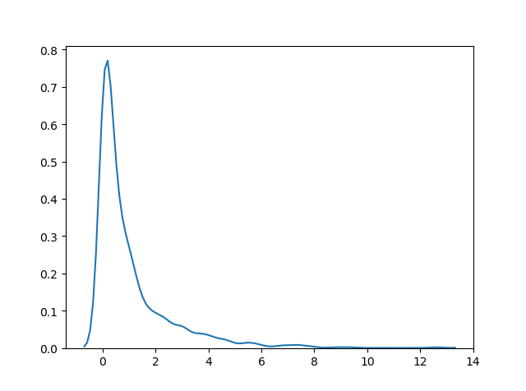
Rayleigh Distribution
Rayleigh distribution is used in signal processing.
It has two parameters:
scale - (standard deviation) decides how flat the distribution will be default 1.0).
size - The shape of the returned array.

Slide 140
eg:Draw out a sample for rayleigh distribution with scale of 2 with size 2x3:
from numpy import random
x = random.rayleigh(scale=2, size=(2, 3))
print(x)
output:
[[1.92690146 0.62601342 3.68332468]
[3.49909368 1.96517528 2.6035816 ]]
Visualization of Rayleigh Distribution
from numpy import random
import matplotlib.pyplot as plt
import seaborn as sns
sns.distplot(random.rayleigh(size=1000), hist=False)
plt.show()

Slide 141
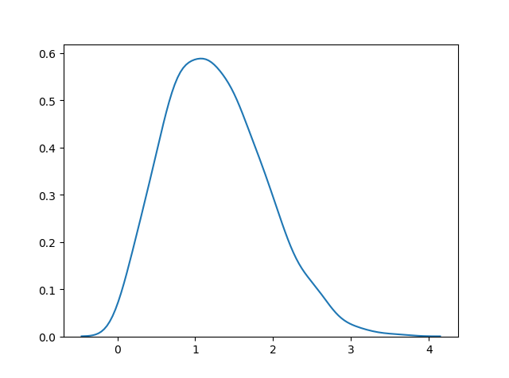

Slide 142
Pareto Distribution
A distribution following Pareto's law i.e. 80-20 distribution (20% factors cause 80% outcome).
It has two parameter:
a - shape parameter.
size - The shape of the returned array.
eg:Draw out a sample for pareto distribution with shape of 2 with size 2x3:
from numpy import random
x = random.pareto(a=2, size=(2, 3))
print(x)

Slide 143
output:
[[0.77719115 0.4802718 1.33000192]
[4.71001252 0.16503083 0.13281105]]
Visualization of Pareto Distribution
from numpy import random
import matplotlib.pyplot as plt
import seaborn as sns
sns.distplot(random.pareto(a=2, size=1000), kde=False)
plt.show()

Slide 144
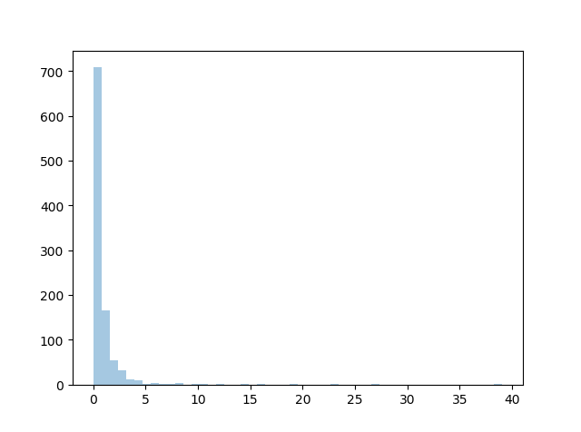

Slide 145
Zipf Distribution
Zipf distributions are used to sample data based on zipf's law.
Zipf's Law: In a collection the nth common term is 1/n times of the most common term. E.g. 5th common word in english has occurs nearly 1/5th times as of the most used word.
It has two parameters:
a - distribution parameter.
size - The shape of the returned array.
eg:Draw out a sample for zipf distribution with distribution parameter 2 with size 2x3:
from numpy import random
x = random.zipf(a=2, size=(2, 3))
print(x)

Slide 146
output:
[[1 1 3]
[1 8 2]]
Visualization of Zipf Distribution
Sample 1000 points but plotting only ones with value < 10 for more meaningful chart.
from numpy import random
import matplotlib.pyplot as plt
import seaborn as sns
x = random.zipf(a=2, size=1000)
sns.distplot(x[x<10], kde=False)
plt.show()

Slide 147
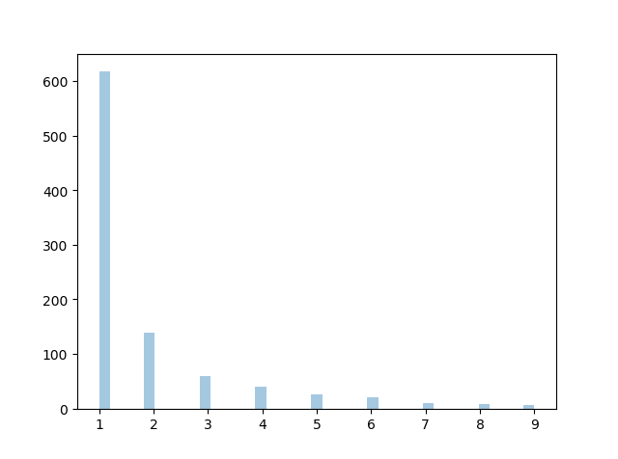

Slide 148
NumPy ufuncs
ufuncs stands for "Universal Functions" and they are NumPy functions that operates on the ndarray object.
Why use ufuncs?
ufuncs are used to implement vectorization in NumPy which is way faster than iterating over elements.
They also provide broadcasting and additional methods like reduce, accumulate etc. that are very helpful for computation.
ufuncs also take additional arguments, like:
where boolean array or condition defining where the operations should take place.
dtype defining the return type of elements.
out output array where the return value should be copied.

Slide 149
What is Vectorization?
Converting iterative statements into a vector based operation is called vectorization.
It is faster as modern CPUs are optimized for such operations.
Add the Elements of Two Lists
list 1: [1, 2, 3, 4]
list 2: [4, 5, 6, 7]
One way of doing it is to iterate over both of the lists and then sum each elements.

Slide 150
Without ufunc, we can use Python's built-in zip() method:
x = [1, 2, 3, 4]
y = [4, 5, 6, 7]
z = []
for i, j in zip(x, y):
z.append(i + j)
print(z)
output:
[5, 7, 9, 11]
NumPy has a ufunc for this, called add(x, y) that will produce the same result.

Slide 151
eg: With ufunc, we can use the add() function:
import numpy as np
x = [1, 2, 3, 4]
y = [4, 5, 6, 7]
z = np.add(x, y)
print(z)
output:
[ 5 7 9 11]

Slide 152
Create Your Own ufunc
To create you own ufunc, you have to define a function, like you do with normal functions in Python, then you add it to your NumPy ufunc library with the frompyfunc() method.
The frompyfunc() method takes the following arguments:
function - the name of the function.
inputs - the number of input arguments (arrays).
outputs - the number of output arrays.
eg: Create your own ufunc for addition:
import numpy as np
def myadd(x, y):
return x+y
myadd = np.frompyfunc(myadd, 2, 1)
print(myadd([1, 2, 3, 4], [5, 6, 7, 8]))

Slide 153
output:
[6 8 10 12]
Check if a Function is a ufunc
Check the type of a function to check if it is a ufunc or not.
A ufunc should return <class 'numpy.ufunc'>.
eg:Check if a function is a ufunc:
import numpy as np
print(type(np.add))

Slide 154
output:
<class 'numpy.ufunc'>
If it is not a ufunc, it will return another type, like this built-in NumPy function for joining two or more arrays:
eg:Check the type of another function: concatenate():
import numpy as np
print(type(np.concatenate))
output:
<class 'builtin_function_or_method'>

Slide 155
If the function is not recognized at all, it will return an error.
To test if the function is a ufunc in an if statement, use the numpy.ufunc value (or np.ufunc if you use np as an alias for numpy):
eg:Use an if statement to check if the function is a ufunc or not:
import numpy as np
if type(np.add) == np.ufunc:
print('add is ufunc')
else:
print('add is not ufunc')
output:
add is ufunc

Slide 156
Simple Arithmetic
We could use arithmetic operators + - * / directly between NumPy arrays, but this section discusses an extension of the same where we have functions that can take any array-like objects e.g. lists, tuples etc. and perform arithmetic conditionally.
Arithmetic Conditionally: means that we can define conditions where the arithmetic operation should happen.
All of the discussed arithmetic functions take a where parameter in which we can specify that condition.

Slide 157
eg:Add the values in arr1 to the values in arr2:
import numpy as np
arr1 = np.array([10, 11, 12, 13, 14, 15])
arr2 = np.array([20, 21, 22, 23, 24, 25])
newarr = np.add(arr1, arr2)
print(newarr)
Output:
The example above will return [30 32 34 36 38 40] which is the sums of 10+20, 11+21, 12+22 etc.

Slide 158
Subtraction
The subtract() function subtracts the values from one array with the values from another array, and return the results in a new array.
eg:Subtract the values in arr2 from the values in arr1:
import numpy as np
arr1 = np.array([10, 20, 30, 40, 50, 60])
arr2 = np.array([20, 21, 22, 23, 24, 25])
newarr = np.subtract(arr1, arr2)
print(newarr)

Slide 159
The example above will return [-10 -1 8 17 26 35] which is the result of 10-20, 20-21, 30-22 etc.
Multiplication
The multiply() function multiplies the values from one array with the values from another array, and return the results in a new array.
eg:Multiply the values in arr1 with the values in arr2:
import numpy as np
arr1 = np.array([10, 20, 30, 40, 50, 60])
arr2 = np.array([20, 21, 22, 23, 24, 25])
newarr = np.multiply(arr1, arr2)
print(newarr)

Slide 160
The example above will return [200 420 660 920 1200 1500] which is the result of 10*20, 20*21, 30*22 etc.
Division
The divide() function divides the values from one array with the values from another array, and return the results in a new array.
eg:Divide the values in arr1 with the values in arr2:
import numpy as np
arr1 = np.array([10, 20, 30, 40, 50, 60])
arr2 = np.array([3, 5, 10, 8, 2, 33])
newarr = np.divide(arr1, arr2)
print(newarr)

Slide 161
The example above will return [3.33333333 4. 3. 5. 25. 1.81818182] which is the result of 10/3, 20/5, 30/10 etc.
Power
The power() function rises the values from the first array to the power of the values of the second array, and return the results in a new array.
eg:Raise the values in arr1 to the power of values in arr2:
import numpy as np
arr1 = np.array([10, 20, 30, 40, 50, 60])
arr2 = np.array([3, 5, 6, 8, 2, 33])
newarr = np.power(arr1, arr2)
print(newarr)

Slide 162
The example above will return [1000 3200000 729000000 6553600000000 2500 0] which is the result of 10*10*10, 20*20*20*20*20, 30*30*30*30*30*30 etc.
Remainder
Both the mod() and the remainder() functions return the remainder of the values in the first array corresponding to the values in the second array, and return the results in a new array.
eg:Return the remainders:
import numpy as np
arr1 = np.array([10, 20, 30, 40, 50, 60])
arr2 = np.array([3, 7, 9, 8, 2, 33])
newarr = np.mod(arr1, arr2)
print(newarr)

Slide 163
The example above will return [1 6 3 0 0 27] which is the remainders when you divide 10 with 3 (10%3), 20 with 7 (20%7) 30 with 9 (30%9) etc.
You get the same result when using the remainder() function:
Quotient and Mod
The divmod() function return both the quotient and the the mod. The return value is two arrays, the first array contains the quotient and second array contains the mod.
eg:

Slide 164
eg:Return the quotient and mod:
import numpy as np
arr1 = np.array([10, 20, 30, 40, 50, 60])
arr2 = np.array([3, 7, 9, 8, 2, 33])
newarr = np.divmod(arr1, arr2)
print(newarr)
The example above will return:
(array([3, 2, 3, 5, 25, 1]), array([1, 6, 3, 0, 0, 27]))
The first array represents the quotients, (the integer value when you divide 10 with 3, 20 with 7, 30 with 9 etc.
The second array represents the remainders of the same divisions.

Slide 165
Absolute Values
Both the absolute() and the abs() functions functions do the same absolute operation element-wise but we should use absolute() to avoid confusion with python's inbuilt math.abs().
eg:Return the quotient and mod:
import numpy as np
arr = np.array([-1, -2, 1, 2, 3, -4])
newarr = np.absolute(arr)
print(newarr)
Output:
The example above will return [1 2 1 2 3 4].

Slide 166
Rounding Decimals
There are primarily five ways of rounding off decimals in NumPy:
truncation
fix
rounding
floor
ceil
Truncation
Remove the decimals, and return the float number closest to zero. Use the trunc() and fix() functions.
eg:Truncate elements of following array:
import numpy as np
arr = np.trunc([-3.1666, 3.6667])
print(arr)

Slide 167
Output:
[-3. 3.]
eg:Same example, using fix():
import numpy as np
arr = np.fix([-3.1666, 3.6667])
print(arr)
Output:
[-3. 3.]

Slide 168
Rounding
The around() function increments preceding digit or decimal by 1 if >=5 else do nothing.
E.g. round off to 1 decimal point, 3.16666 is 3.2.
eg:Round off 3.1666 to 2 decimal places:
import numpy as np
arr = np.around(3.1666, 2)
print(arr)
Output:
3.17

Slide 169
Floor
The floor() function rounds off decimal to nearest lower integer.
E.g. floor of 3.166 is 3.
eg:Floor the elements of following array:
import numpy as np
arr = np.floor([-3.1666, 3.6667])
print(arr)
Output:
[-4,3.]

Slide 170
The floor() function returns floats, unlike the trunc() function who returns integers.
Ceil
The ceil() function rounds off decimal to nearest upper integer.
E.g. ceil of 3.166 is 4.
eg:Ceil the elements of following array:
import numpy as np
arr = np.ceil([-3.1666, 3.6667])
print(arr)

Slide 171
output:
[-3. 4.]
NumPy Logs
Logs
NumPy provides functions to perform log at the base 2, e and 10.
We will also explore how we can take log for any base by creating a custom ufunc.
All of the log functions will place -inf or inf in the elements if the log can not be computed.

Slide 172
Log at Base 2
Use the log2() function to perform log at the base 2.
eg:Find log at base 2 of all elements of following array:
import numpy as np
arr = np.arange(1, 10)
print(np.log2(arr))
output:
[0. 1. 1.5849625 2. 2.32192809 2.5849625
2.80735492 3. 3.169925 ]
The arange(1, 10) function returns an array with integers starting from 1 (included) to 10 (not included).

Slide 173
Log at Base 10
Use the log10() function to perform log at the base 10.
eg:Find log at base 10 of all elements of following array:
import numpy as np
arr = np.arange(1, 10)
print(np.log10(arr))
output:
[0. 0.30103 0.47712125 0.60205999 0.69897 0.77815125
0.84509804 0.90308999 0.95424251]

Slide 174
Natural Log, or Log at Base e
Use the log() function to perform log at the base e.
eg:Find log at base e of all elements of following array:
import numpy as np
arr = np.arange(1, 10)
print(np.log(arr))
output:
[0. 0.69314718 1.09861229 1.38629436 1.60943791 1.79175947
1.94591015 2.07944154 2.19722458]

Slide 175
Log at Any Base
NumPy does not provide any function to take log at any base, so we can use the frompyfunc() function along with inbuilt function math.log() with two input parameters and one output parameter:
eg:from math import log
import numpy as np
nplog = np.frompyfunc(log, 2, 1)
print(nplog(100, 15))
output:
1.7005483074552052

Slide 176
NumPy Summations
What is the difference between summation and addition?
Addition is done between two arguments whereas summation happens over n elements.
eg of add().
Add the values in arr1 to the values in arr2:
import numpy as np
arr1 = np.array([1, 2, 3])
arr2 = np.array([1, 2, 3])
newarr = np.add(arr1, arr2)
print(newarr)

Slide 177
Output will be:[2 4 6]
Same eg when we use sum().
Sum the values in arr1 and the values in arr2:
import numpy as np
arr1 = np.array([1, 2, 3])
arr2 = np.array([1, 2, 3])
newarr = np.sum([arr1, arr2])
print(newarr)
Output will be :12

Slide 178
Summation Over an Axis
If you specify axis=1, NumPy will sum the numbers in each array.
eg:Perform summation in the following array over 1st axis:
import numpy as np
arr1 = np.array([1, 2, 3])
arr2 = np.array([1, 2, 3])
newarr = np.sum([arr1, arr2], axis=1)
print(newarr)
Output will be:[6 6]

Slide 179
Cumulative Sum
Cumulative sum means partially adding the elements in array.
E.g. The partial sum of [1, 2, 3, 4] would be [1, 1+2, 1+2+3, 1+2+3+4] = [1, 3, 6, 10].
Perform partial sum with the cumsum() function.
eg:Perform cummulative summation in the following array:
import numpy as np
arr = np.array([1, 2, 3])
newarr = np.cumsum(arr)
print(newarr)
Output will be:
[1 3 6]

Slide 180
Products
To find the product of the elements in an array, use the prod() function.
Find the product of the elements of this array:
import numpy as np
arr = np.array([1, 2, 3, 4])
x = np.prod(arr)
print(x)
output:
24 (because 1*2*3*4 = 24)

Slide 181
eg: Find the product of the elements of two arrays:
import numpy as np
arr1 = np.array([1, 2, 3, 4])
arr2 = np.array([5, 6, 7, 8])
x = np.prod([arr1, arr2])
print(x)
output:
40320 because 1*2*3*4*5*6*7*8 = 40320
Product Over an Axis
If you specify axis=1, NumPy will return the product of each array.

Slide 182
eg: Perform summation in the following array over 1st axis:
import numpy as np
arr1 = np.array([1, 2, 3, 4])
arr2 = np.array([5, 6, 7, 8])
newarr = np.prod([arr1, arr2], axis=1)
print(newarr)
Output will be:
[24 1680]
Cummulative Product
Cummulative product means taking the product partially.
E.g. The partial product of [1, 2, 3, 4] is [1, 1*2, 1*2*3, 1*2*3*4] = [1, 2, 6, 24]
Perfom partial sum with the cumprod() function.

Slide 183
eg:Take cummulative product of all elements for following array:
import numpy as np
arr = np.array([5, 6, 7, 8])
newarr = np.cumprod(arr)
print(newarr)
Output will be:
[5 30 210 1680]

Slide 184
NumPy Differences
A discrete difference means subtracting two successive elements.
E.g. for [1, 2, 3, 4], the discrete difference would be [2-1, 3-2, 4-3] = [1, 1, 1]
To find the discrete difference, use the diff() function.
eg:Compute discrete difference of the following array:
import numpy as np
arr = np.array([10, 15, 25, 5])
newarr = np.diff(arr)
print(newarr)
output:
[5 10 -20] [because 15-10=5, 25-15=10, and 5-25=-20]

Slide 185
We can perform this operation repeatedly by giving parameter n.
E.g. for [1, 2, 3, 4], the discrete difference with n = 2 would be [2-1, 3-2, 4-3] = [1, 1, 1] , then, since n=2, we will do it once more, with the new result: [1-1, 1-1] = [0, 0]
eg: Compute discrete difference of the following array twice:
import numpy as np
arr = np.array([10, 15, 25, 5])
newarr = np.diff(arr, n=2)
print(newarr)
output:[5 -30] because: 15-10=5, 25-15=10, and 5-25=-20 AND 10-5=5 and -20-10=-30

Slide 186
NumPy LCM Lowest Common Multiple
Finding LCM
The Lowest Common Multiple is the least number that is common multiple of both of the numbers.
eg: Find the LCM of the following two numbers:
import numpy as np
num1 = 4
num2 = 6
x = np.lcm(num1, num2)
print(x)
output:
12 because that is the lowest common multiple of both numbers (4*3=12 and 6*2=12).

Slide 187
Finding LCM in Arrays
To find the Lowest Common Multiple of all values in an array, you can use the reduce() method.
The reduce() method will use the ufunc, in this case the lcm() function, on each element, and reduce the array by one dimension.
eg:Find the LCM of the values of the following array:
import numpy as np
arr = np.array([3, 6, 9])
x = np.lcm.reduce(arr)
print(x)
output:
18 (because that is the lowest common multiple of all three numbers (3*6=18, 6*3=18 and 9*2=18)).

Slide 188
Find the LCM of all of an array where the array contains all integers from 1 to 10:
import numpy as np
arr = np.arange(1, 11)
x = np.lcm.reduce(arr)
print(x)
output:
2520

Slide 189
NumPy GCD Greatest Common Denominator
Finding GCD
The GCD (Greatest Common Denominator), also known as HCF (Highest Common Factor) is the biggest number that is a common factor of both of the numbers.
eg:Find the HCF of the following two numbers:
import numpy as np
num1 = 6
num2 = 9
x = np.gcd(num1, num2)
print(x)
output:3 because that is the highest number both numbers can be divided by (6/3=2 and 9/3=3).

Slide 190
Finding GCD in Arrays
To find the Highest Common Factor of all values in an array, you can use the reduce() method.
The reduce() method will use the ufunc, in this case the gcd() function, on each element, and reduce the array by one dimension.
eg:Find the GCD for all of the numbers in following array:
import numpy as np
arr = np.array([20, 8, 32, 36, 16])
x = np.gcd.reduce(arr)
print(x)
output: 4 because that is the highest number all values can be divided by.

Slide 191
Trigonometric Functions
NumPy provides the ufuncs sin() , cos() and tan() that take values in radians and produce the corresponding sin, cos and tan values.
eg:Find sine value of PI/2:
import numpy as np
x = np.sin(np.pi/2)
print(x)
output:
1.0

Slide 192
eg: Find sine values for all of the values in arr:
import numpy as np
arr = np.array([np.pi/2, np.pi/3, np.pi/4, np.pi/5])
x = np.sin(arr)
print(x)
Output will be: [1. 0.8660254 0.70710678 0.58778525]
Convert Degrees Into Radians
By default all of the trigonometric functions take radians as parameters but we can convert radians to degrees and vice versa as well in NumP.

Slide 193
radians values are pi/180 * degree_values.
eg:Convert all of the values in following array arr to radians:
import numpy as np
arr = np.array([90, 180, 270, 360])
x = np.deg2rad(arr)
print(x)
output:
[1.57079633 3.14159265 4.71238898 6.28318531]

Slide 194
Radians to Degrees
Convert all of the values in following array arr to degrees:
import numpy as np
arr = np.array([np.pi/2, np.pi, 1.5*np.pi, 2*np.pi])
x = np.rad2deg(arr)
print(x)
output:
[ 90. 180. 270. 360.]

Slide 195
Finding Angles
Finding angles from values of sine, cos, tan. E.g. sin, cos and tan inverse (arcsin, arccos, arctan).
NumPy provides ufuncs arcsin(), arccos() and arctan() that produce radian values for corresponding sin, cos and tan values given.
eg:Find the angle of 1.0:
import numpy as np
x = np.arcsin(1.0)
print(x)
output:
1.5707963267948966

Slide 196
Angles of Each Value in Arrays
eg: Find the angle for all of the sine values in the array.
import numpy as np
arr = np.array([1, -1, 0.1])
x = np.arcsin(arr)
print(x)
output:[ 1.57079633 -1.57079633 0.10016742]
Hypotenues
Finding hypotenues using pythagoras theorem in NumPy.
NumPy provides the hypot() function that takes the base and perpendicular values and produces hypotenues based on pythagoras theorem.

Slide 197
Eg: Find the hypotenues for 4 base and 3 perpendicular:
import numpy as np
base = 3
perp = 4
x = np.hypot(base, perp)
print(x)
Output:5.0
NumPy Hyperbolic Functions
NumPy provides the ufuncs sinh(), cosh() and tanh() that take values in radians and produce the corresponding sinh, cosh and tanh values..

Slide 198
eg:Find sinh value of PI/2:
import numpy as np
x = np.sinh(np.pi/2)
print(x)
output:
2.3012989023072947
eg:Find cosh values for all of the values in arr:
import numpy as np
arr = np.array([np.pi/2, np.pi/3, np.pi/4, np.pi/5])
x = np.cosh(arr)
print(x)
output:
[2.50917848 1.60028686 1.32460909 1.20397209]

Slide 199
Finding Angles
Finding angles from values of hyperbolic sine, cos, tan. E.g. sinh, cosh and tanh inverse (arcsinh, arccosh, arctanh).
Numpy provides ufuncs arcsinh(), arccosh() and arctanh() that produce radian values for corresponding sinh, cosh and tanh values given.
Find the angle of 1.0:
import numpy as np
x = np.arcsinh(1.0)
print(x)
output:
0.881373587019543

Slide 200
Angles of Each Value in Arrays
eg:Find the angle for all of the tanh values in array:
import numpy as np
arr = np.array([0.1, 0.2, 0.5])
x = np.arctanh(arr)
print(x)
output:
[0.10033535 0.20273255 0.54930614]

Slide 201
NumPy Set Operations
What is a Set
A set in mathematics is a collection of unique elements.
Sets are used for operations involving frequent intersection, union and difference operations.
Create Sets in NumPy
We can use NumPy's unique() method to find unique elements from any array. E.g. create a set array, but remember that the set arrays should only be 1-D arrays.

Slide 202
eg:Convert following array with repeated elements to a set:
import numpy as np
arr = np.array([1, 1, 1, 2, 3, 4, 5, 5, 6, 7])
x = np.unique(arr)
print(x)
output:
[1 2 3 4 5 6 7]
Finding Union
To find the unique values of two arrays, use the union1d() method.

Slide 203
Eg: Find intersection of the following two set arrays:
import numpy as np
arr1 = np.array([1, 2, 3, 4])
arr2 = np.array([3, 4, 5, 6])
newarr = np.intersect1d(arr1, arr2, assume_unique=True)
print(newarr)
output:
[3 4]
the intersect1d() method takes an optional argument assume_unique, which if set to True can speed up computation. It should always be set to True when dealing with sets.

Slide 204
Finding Difference
To find only the values in the first set that is NOT present in the seconds set, use the setdiff1d() method.
eg:Find the difference of the set1 from set2:
import numpy as np
set1 = np.array([1, 2, 3, 4])
set2 = np.array([3, 4, 5, 6])
newarr = np.setdiff1d(set1, set2, assume_unique=True)
print(newarr)
output:
[1 2]

Slide 205
the setdiff1d() method takes an optional argument assume_unique, which if set to True can speed up computation. It should always be set to True when dealing with sets.
Finding Symmetric Difference
To find only the values that are NOT present in BOTH sets, use the setxor1d() method.
eg:Find the symmetric difference of the set1 and set2:
import numpy as np
set1 = np.array([1, 2, 3, 4])
set2 = np.array([3, 4, 5, 6])
newarr = np.setxor1d(set1, set2, assume_unique=True)
print(newarr)
Output:[1 2 5 6]
the setxor1d() method takes an optional argument assume_unique, which if set to True can speed up computation. It should always be set to True when dealing with sets.

Slide 206
Thankyou

